Slide 2

EAT4FIT
FIT-FOOD FIT-LIFE

Slide 3
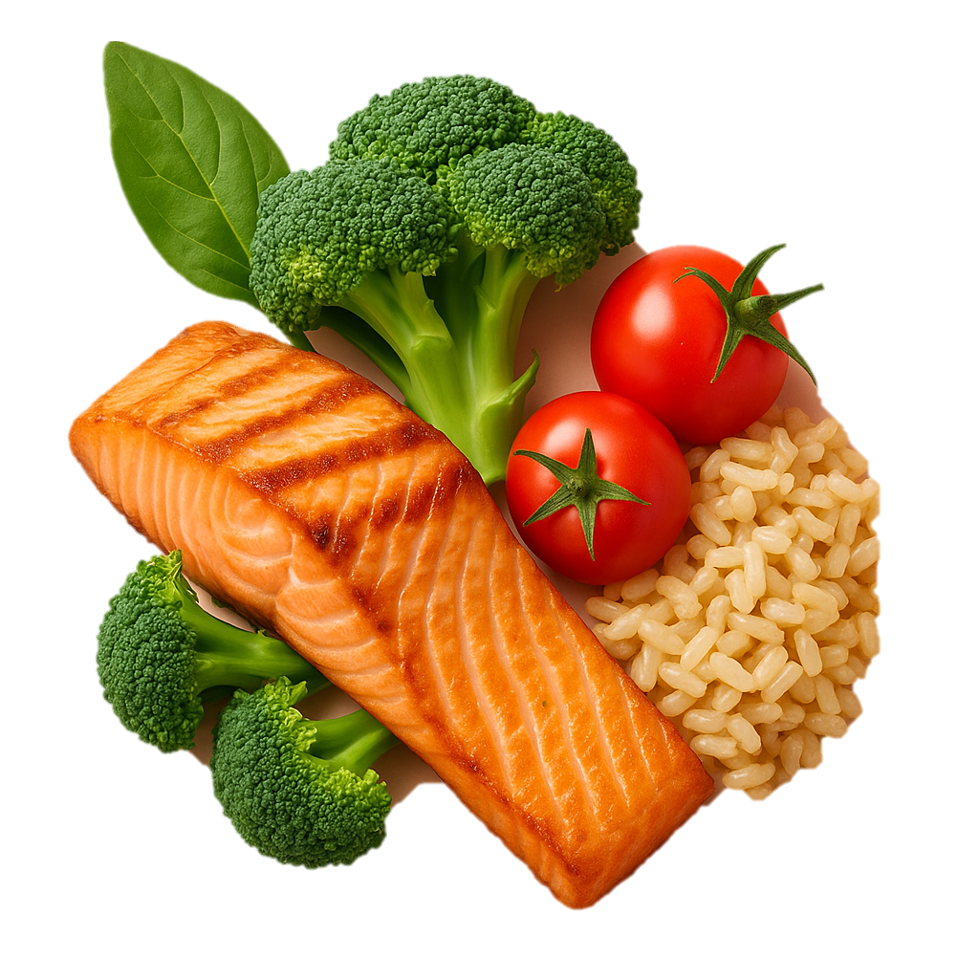
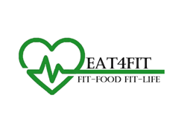
Healthy Meal
EAT4FIT
www.eat4fit.in
EAT4FIT
Eat4Fit is a Patna-based healthy meal delivery startup offering AI-powered, fully customizable meals designed for fitness enthusiasts, working professionals, students, patients, and even celebrities.
We deliver fresh, dietician-approved meals to multiple locations per customer—be it home, office, gym, or hostel—offering unmatched convenience.With FREE 24×7 dietician support, eco-friendly packaging, and affordable pricing, Eat4Fit makes healthy eating easy, accessible, and sustainable.We’re not just feeding people — we’re empowering India to live healthier, one personalized meal at a time.
FIT-FOOD FIT-LIFE

Slide 4
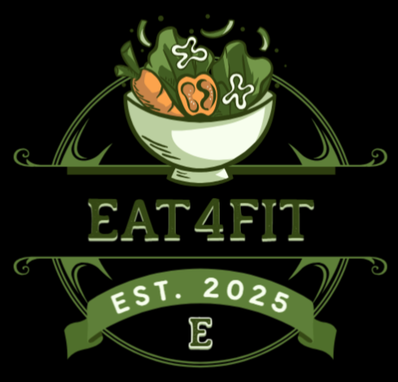
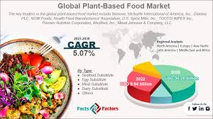
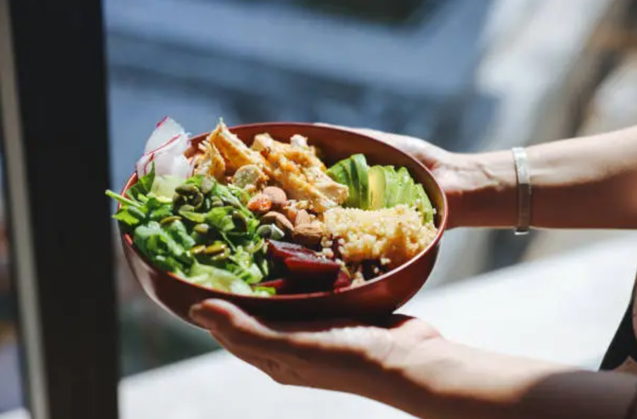
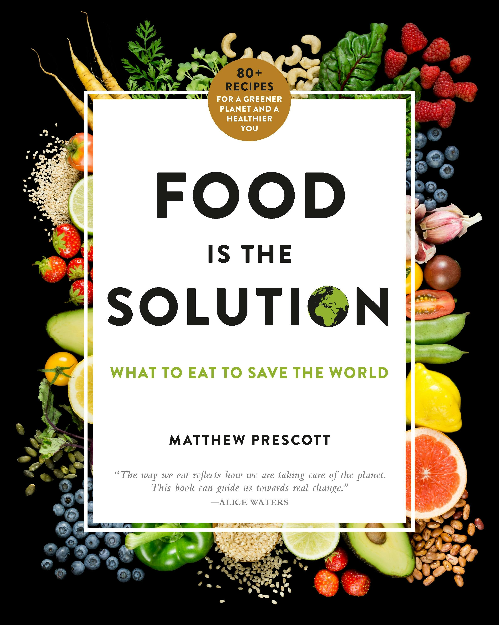
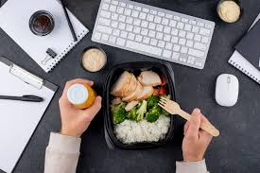

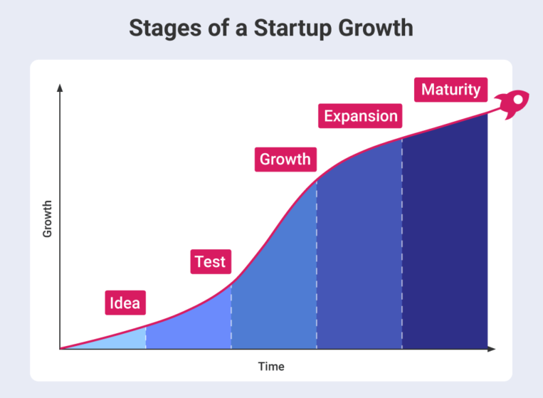
EAT4FIT
www.eat4fit.in
EAT4FIT
Eat4Fit is a Bihar-based healthy meal delivery startup offering AI-powered, fully customizable meals designed for fitness enthusiasts, working professionals, students, patients, and even celebrities.
We deliver fresh, dietician-approved meals to multiple locations per customer—be it home, office, gym, or hostel—offering unmatched convenience.With FREE 24×7 dietician support, eco-friendly packaging, and affordable pricing, Eat4Fit makes healthy eating easy, accessible, and sustainable.We’re not just feeding people — we’re empowering India to live healthier, one personalized meal at a time.
Healthy Meal Company

Slide 5

www.eat4fit.in
The Problem & Opportunity
01
EAT4FIT
FIT-FOOD FIT-LIFE

Slide 6

www.eat4fit.in
01
02
The Problem & Opportunity
Solution We are Providing
1.Healthy Meals Are Either Unavailable or Unaffordable in Bihar
• No dedicated service offers nutritious + tasty + affordable daily meals.
2.No Personalization in Existing Meal Services
• Local tiffin/dabba services follow a one-size-fits-all model.(weight loss, diabetes, protein-rich, etc.)
3.No Multi-Location Delivery Options
• Working professionals and students can’t get meals delivered to different places (home in morning, office at lunch, gym at night).
4.No Real-Time Nutrition Guidance
• No service offers free, 24x7 dietician access for meal planning.
5.Hostel/PG Students & Patients Are Ignored
• Students & patients often eat unhygienic or junk food due to lack of healthy, affordable options.
The Gap:
There is no service in Bihar that offers health-focused, personalized, and location-flexible meals with expert support at an affordable price.
1.Fully Customizable Meals
• AI and nutritionist powered personalised meal for user goals: weight loss, muscle gain, diabetic care, detox, etc.
2.Multi-Address Daily Delivery
• Meals delivered to different locations per day (home, office, gym, hostel), matching user routines — a first in this segment.
3.24×7 Free Dietician Support
• Real-time chat/call access to certified dieticians for continuous guidance — building trust and long-term health impact.
4.Affordable Pricing for All Segments
• Pocket-friendly for students, professionals, families, and even patients
5.Locally Prepared, Fresh & Tasty Food
• Cooked in hygienic local kitchens daily — not mass-produced or frozen
• Menus blend taste and nutrition for sustainable healthy eating.
Eat4Fit makes healthy eating easy, affordable, personalized, and accessible — anytime, anywhere in Patna.

Slide 7
www.eat4fit.in
03
02
Industry Size
Solution We are Providing
1.Fully Customizable Meals
• AI and nutritionist powered personalised meal for user goals: weight loss, muscle gain, diabetic care, detox, etc.
2.Multi-Address Daily Delivery
• Meals delivered to different locations per day (home, office, gym, hostel), matching user routines — a first in this segment.
3.24×7 Free Dietician Support
• Real-time chat/call access to certified dieticians for continuous guidance — building trust and long-term health impact.
4.Affordable Pricing for All Segments
• Pocket-friendly for students, professionals, families, and even patients
5.Locally Prepared, Fresh & Tasty Food
• Cooked in hygienic local kitchens daily — not mass-produced or frozen
• Menus blend taste and nutrition for sustainable healthy eating.
Eat4Fit makes healthy eating easy, affordable, personalized, and accessible — anytime, anywhere in Patna.
Target Location: Patna
Population: ~25–30 lakh, Primary Target: ~7–8 lakh
Potential Health-Conscious Consumers: ~1.5–2 lakh
Serviceable Available Market (SAM) – Patna Monthly Meal Spend (avg): ₹100 per meal × 2 meals/day × 30 days = ₹6,000/monthEstimated Users You Can Target in 1st Year: 5,000–10,000 Local SAM (Patna): ₹30–60 Cr/year
Total Addressable Market (TAM)
• India’s health-focused meal industry is growing at >20% CAGR
• Urban India has ~10 crore+ potential fitness-conscious customers
• TAM: ₹30,000+ Cr (and growing) — including cities like Patna, Ranchi, Lucknow, Pune, etc.Why This is Exciting:
• Patna is a first-mover opportunity with no organized healthy meal service
• Rising fitness awareness + affordability gap = high growth space
• Easy to scale regionally after proven pilot success
Patna alone is a ₹30–60 Cr untapped annual market — Eat4Fit is entering with the right model at the right time.

Slide 8
www.eat4fit.in
04
03
Value Preposition & USP
Industry Size
Target Location: Patna
Population: ~25–30 lakh, Primary Target: ~7–8 lakh
Potential Health-Conscious Consumers: ~1.5–2 lakh
Serviceable Available Market (SAM) – Patna Monthly Meal Spend (avg): ₹100 per meal × 2 meals/day × 30 days = ₹6,000/monthEstimated Users You Can Target in 1st Year: 5,000–10,000 Local SAM (Patna): ₹30–60 Cr/year
Total Addressable Market (TAM)
• India’s health-focused meal industry is growing at >20% CAGR
• Urban India has ~10 crore+ potential fitness-conscious customers
• TAM: ₹30,000+ Cr (and growing) — including cities like Patna, Ranchi, Lucknow, Pune, etc.Why This is Exciting:
• Patna is a first-mover opportunity with no organized healthy meal service
• Rising fitness awareness + affordability gap = high growth space
• Easy to scale regionally after proven pilot success
Patna alone is a ₹30–60 Cr untapped annual market — Eat4Fit is entering with the right model at the right time.
1. Multi-Address Daily Delivery (First-of-its-Kind in India)
• Customers can receive different meals at home, office, gym, or hostel, as per their daily routine — offering unmatched convenience.
2. Free 24×7 Dietician Support
• Every customer gets unlimited access to certified dieticians via call/chat — personalized nutrition guidance at no extra cost.
3. Fully Customizable, Fresh, Hygienic Meal Plans
• Powered by AI & expert dieticians — choose meals based on goals & desire.
• Our meals are freshly made every day, with high taste and hygiene standards.
4. Focused on Bihar – a High-Demand, Underserved Market
• No other branded healthy meal service exists in Bihar — we are first movers with local operations and regional understanding.
5. Affordable Pricing for Every Segment
• Designed to serve students, working professionals, patients, and celebrities with flexible daily, weekly, and monthly packages.

Slide 9
www.eat4fit.in
05
04
Business Model.
Value Preposition & USP
1. Revenue Streams
• Subscriptions (₹120/meal) – 65%* • Corporate Wellness – 15%
• Custom Health Plans – 10% • Instant Orders & Add-ons – 10%
Avg. User Revenue/Month = ₹7,200
2. Cost per Meal
• Ingredients + Cooking: ₹45 • Staff + Utilities: ₹15
• Delivery + Packaging: ₹15 • Marketing/Tech: ₹5Total
Avg. Cost: ₹75
3. Profit & Metrics
• Gross Profit/User: ₹2,700 • Margin: 37.5%
• CLTV: ₹32,400 • CAC: ₹800–₹1,000
Profitable per user from Month 1
4. Year 1 Target – Patna Launch
• 1,000 users → ₹72L/month revenue • ₹27L/month gross profit
• Break-even in 6–8 months
5. Ops Model
• Central kitchen + local pickups • AI meal planning + dietician support
• Multi-location delivery (home, office, gym)
Subscription-driven & low wastage
---Eat4Fit = Scalable, profitable, and health-focused meal delivery for Bihar.
1. Multi-Address Daily Delivery (First-of-its-Kind in India)
• Customers can receive different meals at home, office, gym, or hostel, as per their daily routine — offering unmatched convenience.
2. Free 24×7 Dietician Support
• Every customer gets unlimited access to certified dieticians via call/chat — personalized nutrition guidance at no extra cost.
3. Fully Customizable, Fresh, Hygienic Meal Plans
• Powered by AI & expert dieticians — choose meals based on goals & desire.
• Our meals are freshly made every day, with high taste and hygiene standards.
4. Focused on Bihar – a High-Demand, Underserved Market
• No other branded healthy meal service exists in Bihar — we are first movers with local operations and regional understanding.
5. Affordable Pricing for Every Segment
• Designed to serve students, working professionals, patients, and celebrities with flexible daily, weekly, and monthly packages.

Slide 10
www.eat4fit.in
06
05
1. Revenue Streams
• Subscriptions (₹120/meal) – 65%* • Corporate Wellness – 15%
• Custom Health Plans – 10% • Instant Orders & Add-ons – 10%
Avg. User Revenue/Month = ₹7,200
2. Cost per Meal
• Ingredients + Cooking: ₹45 • Staff + Utilities: ₹15
• Delivery + Packaging: ₹15 • Marketing/Tech: ₹5Total
Avg. Cost: ₹75
3. Profit & Metrics
• Gross Profit/User: ₹2,700 • Margin: 37.5%
• CLTV: ₹32,400 • CAC: ₹800–₹1,000
Profitable per user from Month 1
4. Year 1 Target – Patna Launch
• 1,000 users → ₹72L/month revenue • ₹27L/month gross profit
• Break-even in 6–8 months
5. Ops Model
• Central kitchen + local pickups • AI meal planning + dietician support
• Multi-location delivery (home, office, gym)
Subscription-driven & low wastage
---Eat4Fit = Scalable, profitable, and health-focused meal delivery for Bihar.
Current Status of Startup
Business Model.
Current Stage: Validation done
Pilot starting in Patna (100 users)
Survey Highlights (140 Urban Patna Users)
• 52% Male, 63% aged 18–24 • 78% are students/office-goers
• 90% want office delivery • 70% want fresh, hot lunch
• 80% struggle to find healthy meals • 95% order food online
• Price comfort: ₹100–₹180
Internal Progress
• Problem & demand validated • Business model & margins (37%+)
• Revenue streams mapped • Pitch & projections ready
• Pilot execution in progress
Why Now?
• Rising health focus post-COVID • Tier 2 cities lack healthy options
• Patna has strong workplace meal demand
Conclusion Eat4Fit is validated, affordable, tech-driven & ready to scale.

Slide 11
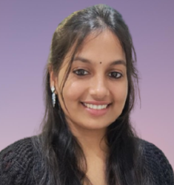
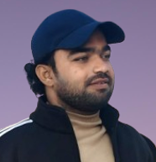
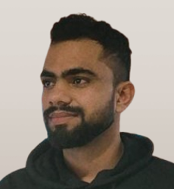
Rani Kumari
Co-Founder & Nutritionist
www.eat4fit.in
06
Current Status of Startup
Current Stage: Validation done
Pilot starting in Patna (100 users)
Survey Highlights (140 Urban Patna Users)
• 52% Male, 63% aged 18–24 • 78% are students/office-goers
• 90% want office delivery • 70% want fresh, hot lunch
• 80% struggle to find healthy meals • 95% order food online
• Price comfort: ₹100–₹180
Internal Progress
• Problem & demand validated • Business model & margins (37%+)
• Revenue streams mapped • Pitch & projections ready
• Pilot execution in progress
Why Now?
• Rising health focus post-COVID • Tier 2 cities lack healthy options
• Patna has strong workplace meal demand
Conclusion Eat4Fit is validated, affordable, tech-driven & ready to scale.
Imran Khan
Md Arshad Khan
Co-Founder & Head of
Operations
Co-Founder & CEO

Slide 12
Thank You
www.eat4fit.in
07
Team Introduction
Md Arshad Khan
Rani Kumari
Imran Khan
Co-Founder & CEO
Co-Founder & Nutritionist
Co-Founder & Head of
Operations

Slide 13
www.eat4fit.in
Our Team
Thank You

